Slide 1
FWD Project
TOGAF 9 – Core Diagrams
Environments and Locations Diagram
Phase D – Technology Architecture

Slide 2

Environments and Locations Diagram
WAN
LAN
Processing
Channels
Data Management Services
Infrastructure Monitoring & Control
WAN
LAN
Processing
Channels
Data Management Services
Infrastructure Monitoring & Control
WAN
LAN
Processing
Channels
Data Management Services
Infrastructure Monitoring & Control
WAN
LAN
Processing
Channels
WAN
Processing
Channels
Satellite Sites
Print
Office Automation
Print
Directory
Print
Print
Print
Office Automation
Software Distribution
Office Automation
Software Distribution
Office Automation
Office Automation
Messaging
Legacy Services
Messaging
Legacy Services
Messaging
Legacy Services
Legacy Services
Security (AV)
Security (AV)
LAN
LAN
LAN
LAN
Large Site
Medium Site A
Medium Site B
Small Site
Home Users

Slide 3



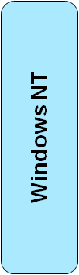
Environments and Locations Diagram
Location 1
Location 2
Location 3
Location 4

